Slide 1
Essay title, lit review and research project proposal
Lit review: case analysis of the ‘Wolf Man’ and its involvement in oneirology (the study of dreams)
Dream analysis, The different layers and what has been done to understand them over the years
Essay title (possible ideas):
creation and exploration in video games: the process of making worlds for the player to invest in
Lucid exploration of imaginary worlds
The power of the creator in video games
(both the team who develop it as well as the player as they progress)

Slide 2
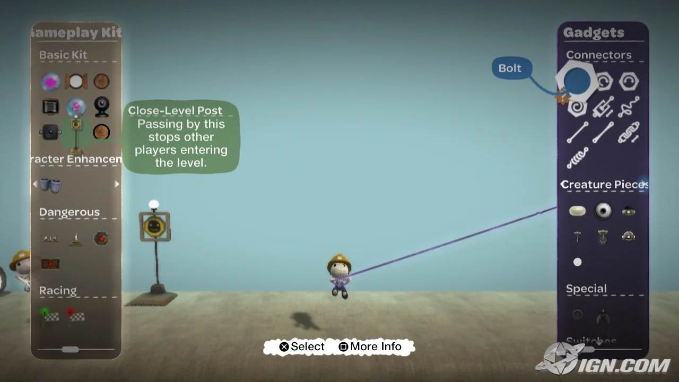
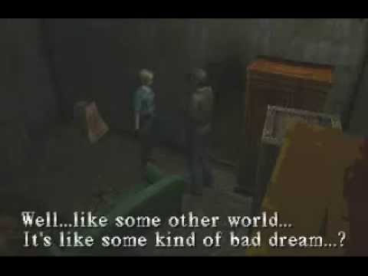
Analyse of dreams and the study of oneirology in connection to psychoanalysis.
Free rein to create vs following a set narrative
The place dreams have in video games as a genre/ style, how it’s used with the setting and in creating a story driven game.
Proposed question and main case study or example id analyse:
Exploration and creation in ‘dream-scapes’, how can imaginary places and the ability to freely create within them lead to a type of ‘magic’ only seen in dreams?
Silent hill (1st game) ps1
Little big planet (1st game) ps3
Nights into dreams, sega saturn
LSD: dream simulator, ps1
Lucid dreams, what they are and why there so interesting both to experience as well as to figure out how they work

Slide 3
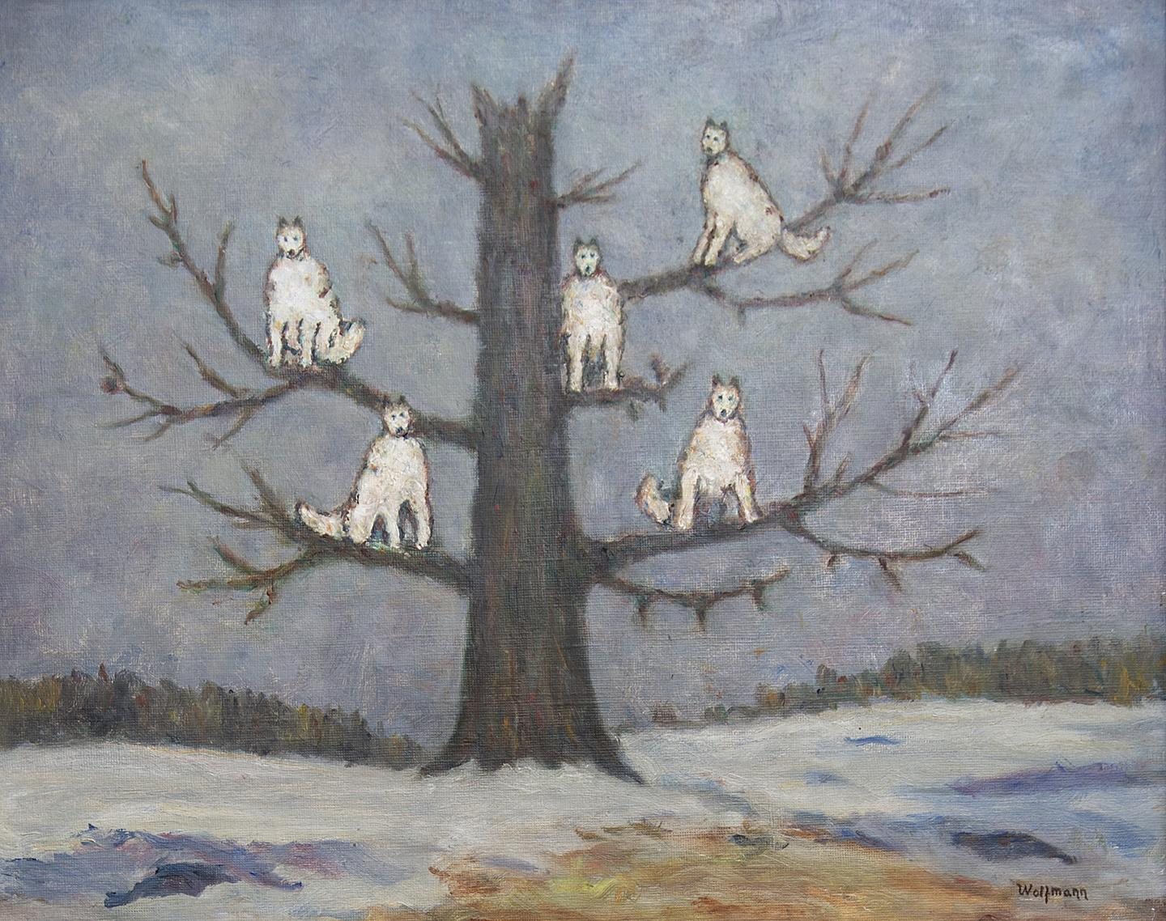
Study of oneirology, sleep paralysis and lucid dreaming
Dream therapy and the inner workings of a ‘dream’
Siegmund freud ‘wolf man’ patient and the study to come from it?
Proposed topic on literature review, possible sub topics and questions and list of resources
Hill, C. E., & Spangler, P. (2007). Dreams and psychotherapy
Ancient Science and Dreams: Oneirology in Greco-Roman Antiquity
By Mark Holowchak
Dream journals
hall/Van de Castle coding dream content
Dream dictionaries human knowledge vs psychology and science

Slide 4
Research project proposal idea
Any possible research material that you think will support your proposal at this stage
Tarot cards: interpretation
James hillman
Dreams and the underworld
Archetypal pyshcology
Alejandro Jodorowsky
Videogames with a dream motif: “dreams” ps4, “nights into dreams” sega saturn, LSD: dream simulator ps1,
Study of my own dreams? Dream journal
‘Waking life’

